Slide 1

God’s Word Comforts
Psalms 119:74-80
Notes:
Stuart Fain ~ March 23, 2010 (Apache Junction Lectureship)
~ February 22, 2025 (Eloy backup for preacher sick)

Slide 2
Psalms 119:74-80 (KJV)
⁷⁴ They that fear thee will be glad when they see me; because I have hoped in thy word. ⁷⁵ I know, O Lord, that thy judgments are right, and that thou in faithfulness hast afflicted me.

Slide 3
Psalms 119:74-80 (KJV)
⁷⁶ Let, I pray thee, thy merciful kindness be for my comfort, according to thy word unto thy servant. ⁷⁷ Let thy tender mercies come unto me, that I may live: for thy law is my delight.

Slide 4
I John 2:10-11 (NKJV)
¹⁰ He who loves his brother abides in the light, and there is no cause for stumbling in him. ¹¹ But he who hates his brother is in darkness and walks in darkness, and does not know where he is going, because the darkness has blinded his eyes.

Slide 5
I Corinthians 12:18 (NKJV)
But now God has set the members, each one of them, in the body just as He pleased.

Slide 6
Psalms 119:49-50 (NASB)
⁴⁹ Remember the word to Your servant, In which You have made me hope.
⁵⁰ This is my comfort in my misery, That Your word has revived me.

Slide 7
II Corinthians 1:3-6 (KJV)
³ Blessed be God, even the Father of our Lord Jesus Christ, the Father of mercies, and the God of all comfort;
⁴ Who comforteth us in all our tribulation, that we may be able to comfort them which are in any trouble,

Slide 8
II Corinthians 1:3-6 (KJV)
by the comfort wherewith we ourselves are comforted of God.
⁵ For as the sufferings of Christ abound in us, so our consolation also aboundeth by Christ.

Slide 9
II Corinthians 1:3-6 (KJV)
⁶ And whether we be afflicted, it is for your consolation and salvation, which is effectual in the enduring of the same sufferings which we also suffer: or whether we be comforted, it is for your consolation and salvation.

Slide 10
Mathew 11:28-30 (KJV)
²⁸ Come unto me, all ye that labour and are heavy laden, and I will give you rest. ²⁹ Take my yoke upon you, and learn of me; for I am meek and lowly in heart: and ye shall find rest unto your souls. ³⁰ For my yoke is easy, and my burden is light.

Slide 11
Mark 4:35-40 (KJV)
³⁵ And the same day, when the even was come, he saith unto them, Let us pass over unto the other side.
³⁶ And when they had sent away the multitude, they took him even as he was in the ship. And there were also with him other little ships.

Slide 12
Mark 4:35-40 (KJV)
³⁷ And there arose a great storm of wind, and the waves beat into the ship, so that it was now full.
³⁸ And he was in the hinder part of the ship, asleep on a pillow: and they awake him, and say unto him, Master, carest thou not that we perish?

Slide 13
Mark 4:35-40 (KJV)
³⁹ And he arose, and rebuked the wind, and said unto the sea, Peace, be still. And the wind ceased, and there was a great calm.
⁴⁰ And he said unto them, Why are ye so fearful? how is it that ye have no faith?

Slide 14
I Thessalonians 3:11-13 (NKJV)
¹¹ Now may our God and Father Himself, and our Lord Jesus Christ, direct our way to you. ¹² And may the Lord make you increase and abound in love to one another and to all, just as we do to you,

Slide 15
I Thessalonians 3:11-13 (NKJV)
¹³ so that He may establish your hearts blameless in holiness before our God and Father at the coming of our Lord Jesus Christ with all His saints.

Slide 16
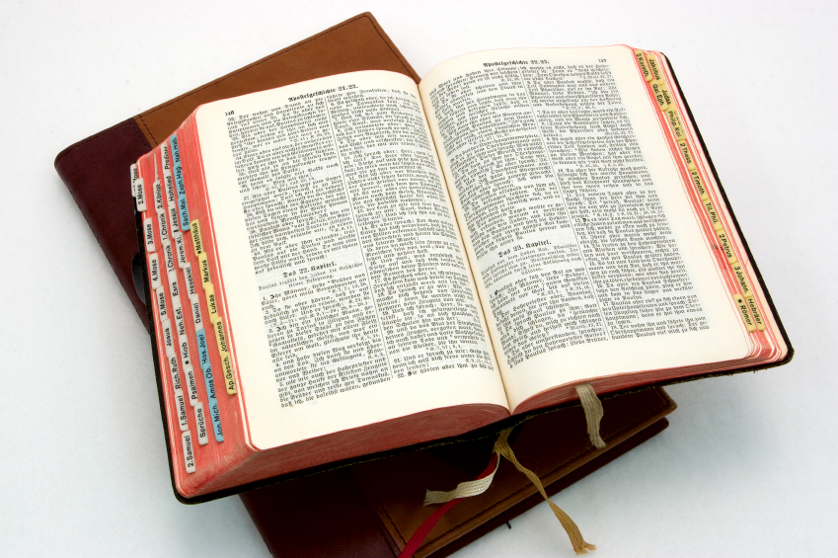
Hear: Romans 10:17
So then faith cometh by hearing, and hearing by the word of God.

Slide 17
Believe: Hebrews 11:6
But without faith it is impossible to please him: for he that cometh to God must believe that he is, and that he is a rewarder of them that diligently seek him.

Slide 18
Repent: Luke 13:3
I tell you, Nay: but, except ye repent, ye shall all likewise perish.

Slide 19
Confess: Matthew 10:32-33
32 Whosoever therefore shall confess me before men, him will I confess also before my Father which is in heaven.
33 But whosoever shall deny me before men, him will I also deny before my Father which is in heaven.

Slide 20
Baptize: Acts 22:16
And now why tarriest thou? arise, and be baptized, and wash away thy sins, calling on the name of the Lord.

